Slide 1
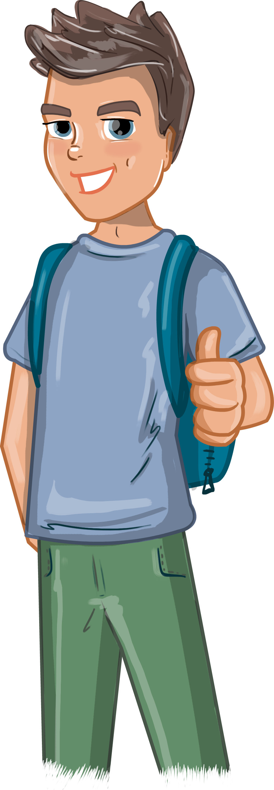
Online Safety -
our friends online
Notes:
ZEEKO
www.zeeko.ie
Expert researchers in Internet Safety. Based in NovaUCD in Dublin.
Some research statistics to raise awareness:
MORE BOYS THAN GIRLS have reported speaking with strangers online (27% boys Vs 11% girls)
56% of boys and 24% of girls have played with or against a stranger online
Parent Advice:
To advise parents on this issue, Dr Marina Everri, Head of Research at Zeeko recommends the following:
OPEN COMMUNICATION: Talk with your children about their Internet use and practice co-use.
ACTIVE LISTENING: Listen in a non-judgemental way. Children who are defensive cannot listen and children who cannot listen cannot learn.
MONITOR & CONTROL: This is different from intrusion and control.

Slide 2
ONLINE Friends
Notes:
Online Friends
Together with your students, you can discuss catfishing and online friends.
Ask the students what catfishing is. Zeeko’s experience is that many primary school students do know what catfishing is.
Catfishing is when someone sets up a fake account in order to lie about their identity online. They use various aliases (names, personalities) to trick people into talking to them.
Zeeko recommends some basic guidelines around how to engage with people online.
First, start the conversation with the class using Molly as an example (next slide).

Slide 3
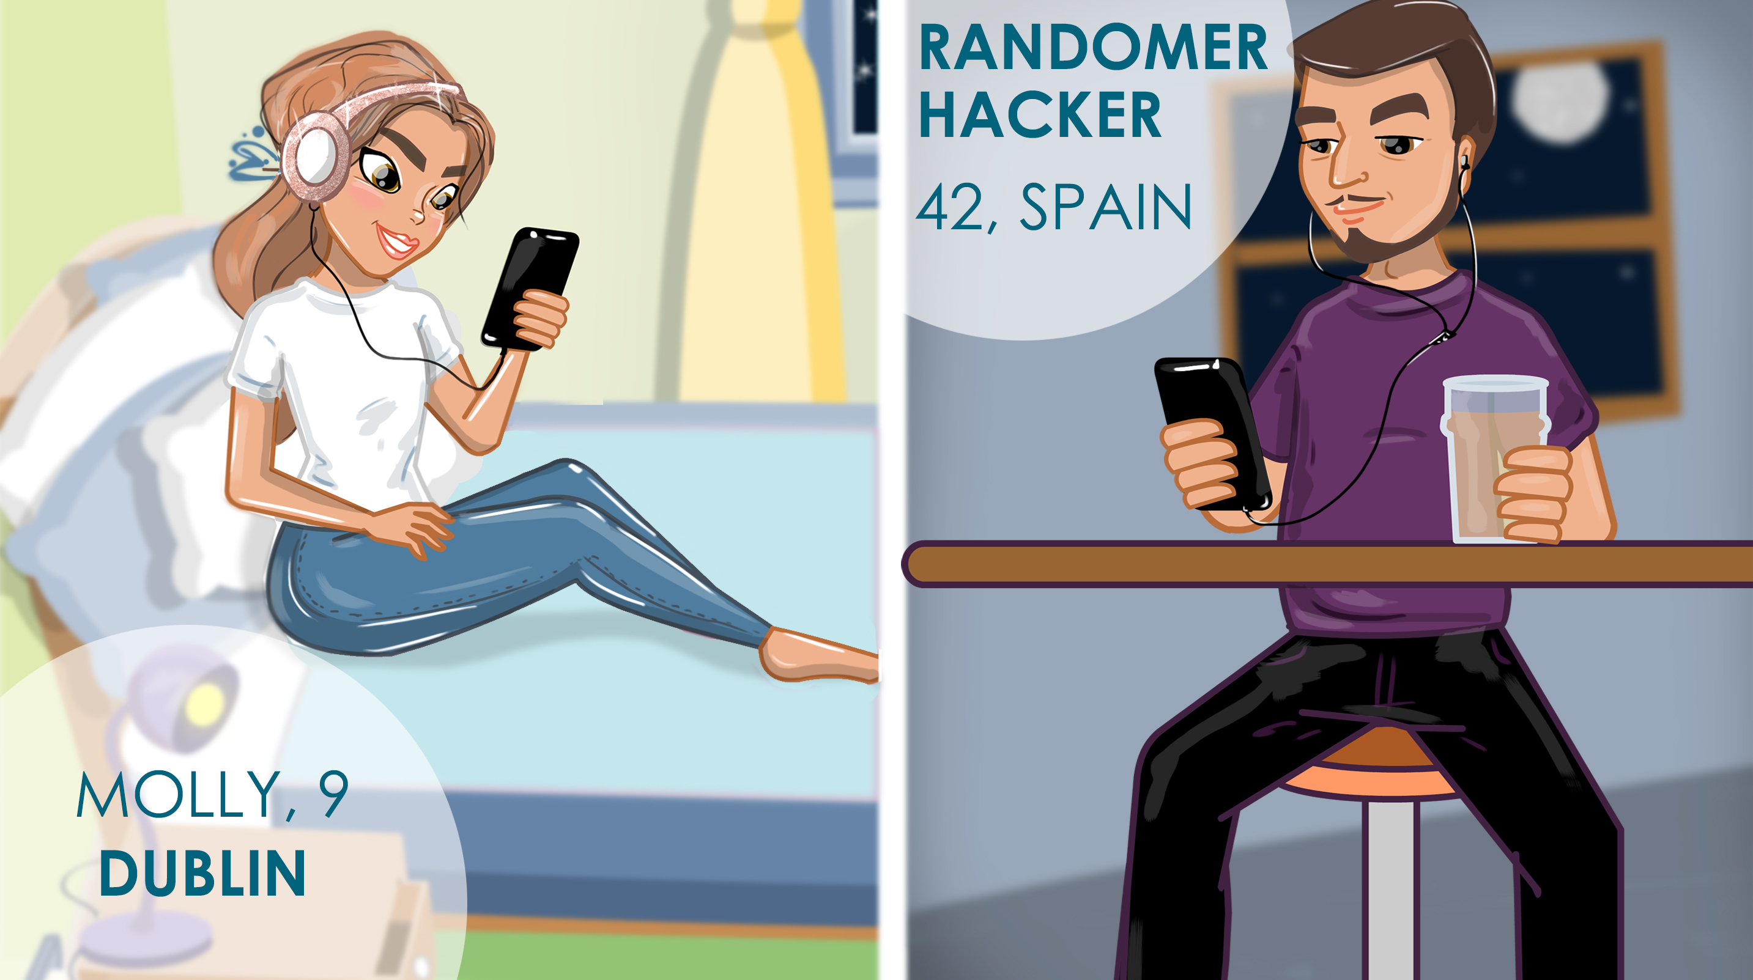
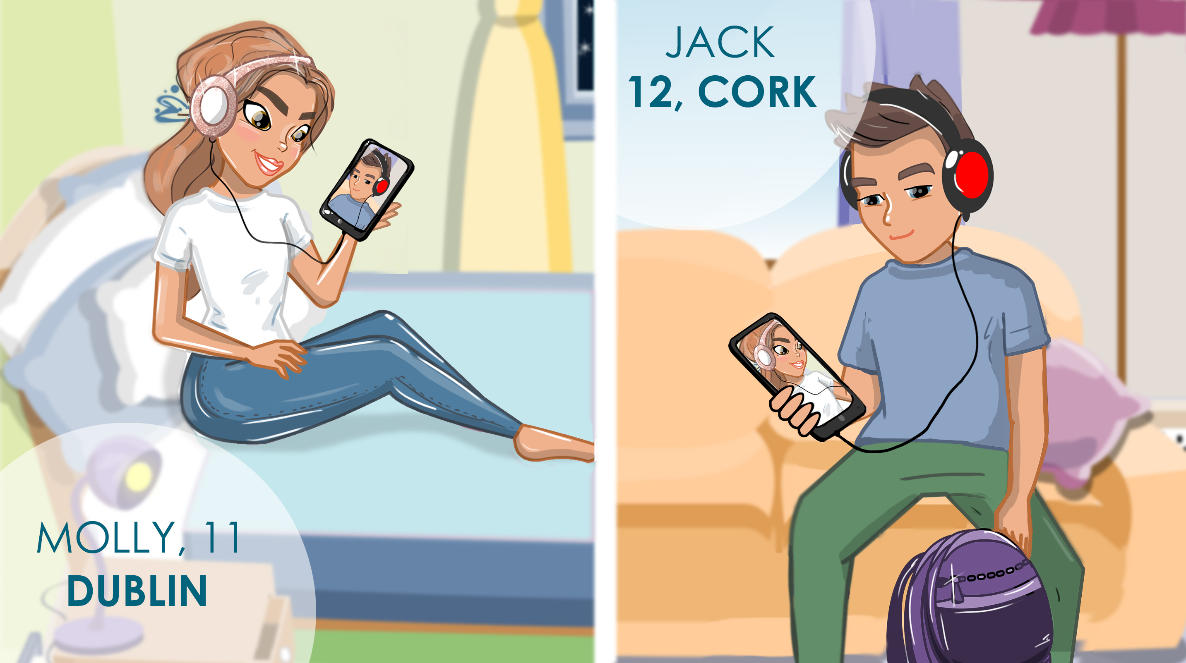
Notes:
Molly Scenario A
Molly and Jack know each other in real life since a very young age. They have exchanged user names from being friends in the real world. Both their families have a holiday mobile home where they go every summer. They chat from time to time online.
Discuss with the students about what is good and/or bad about communicating online.
Discuss with the students what family members (who may live abroad) they talk to on Facetime and/or Skype.
Ask the students why it is ok to talk to people online they know from the real world first.

Slide 4
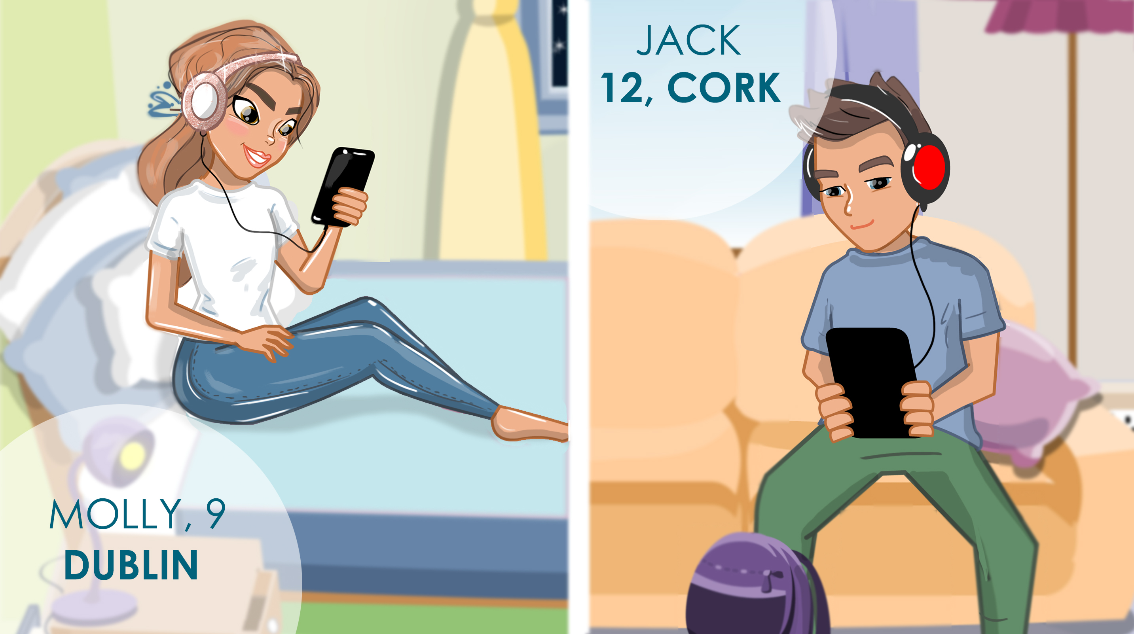
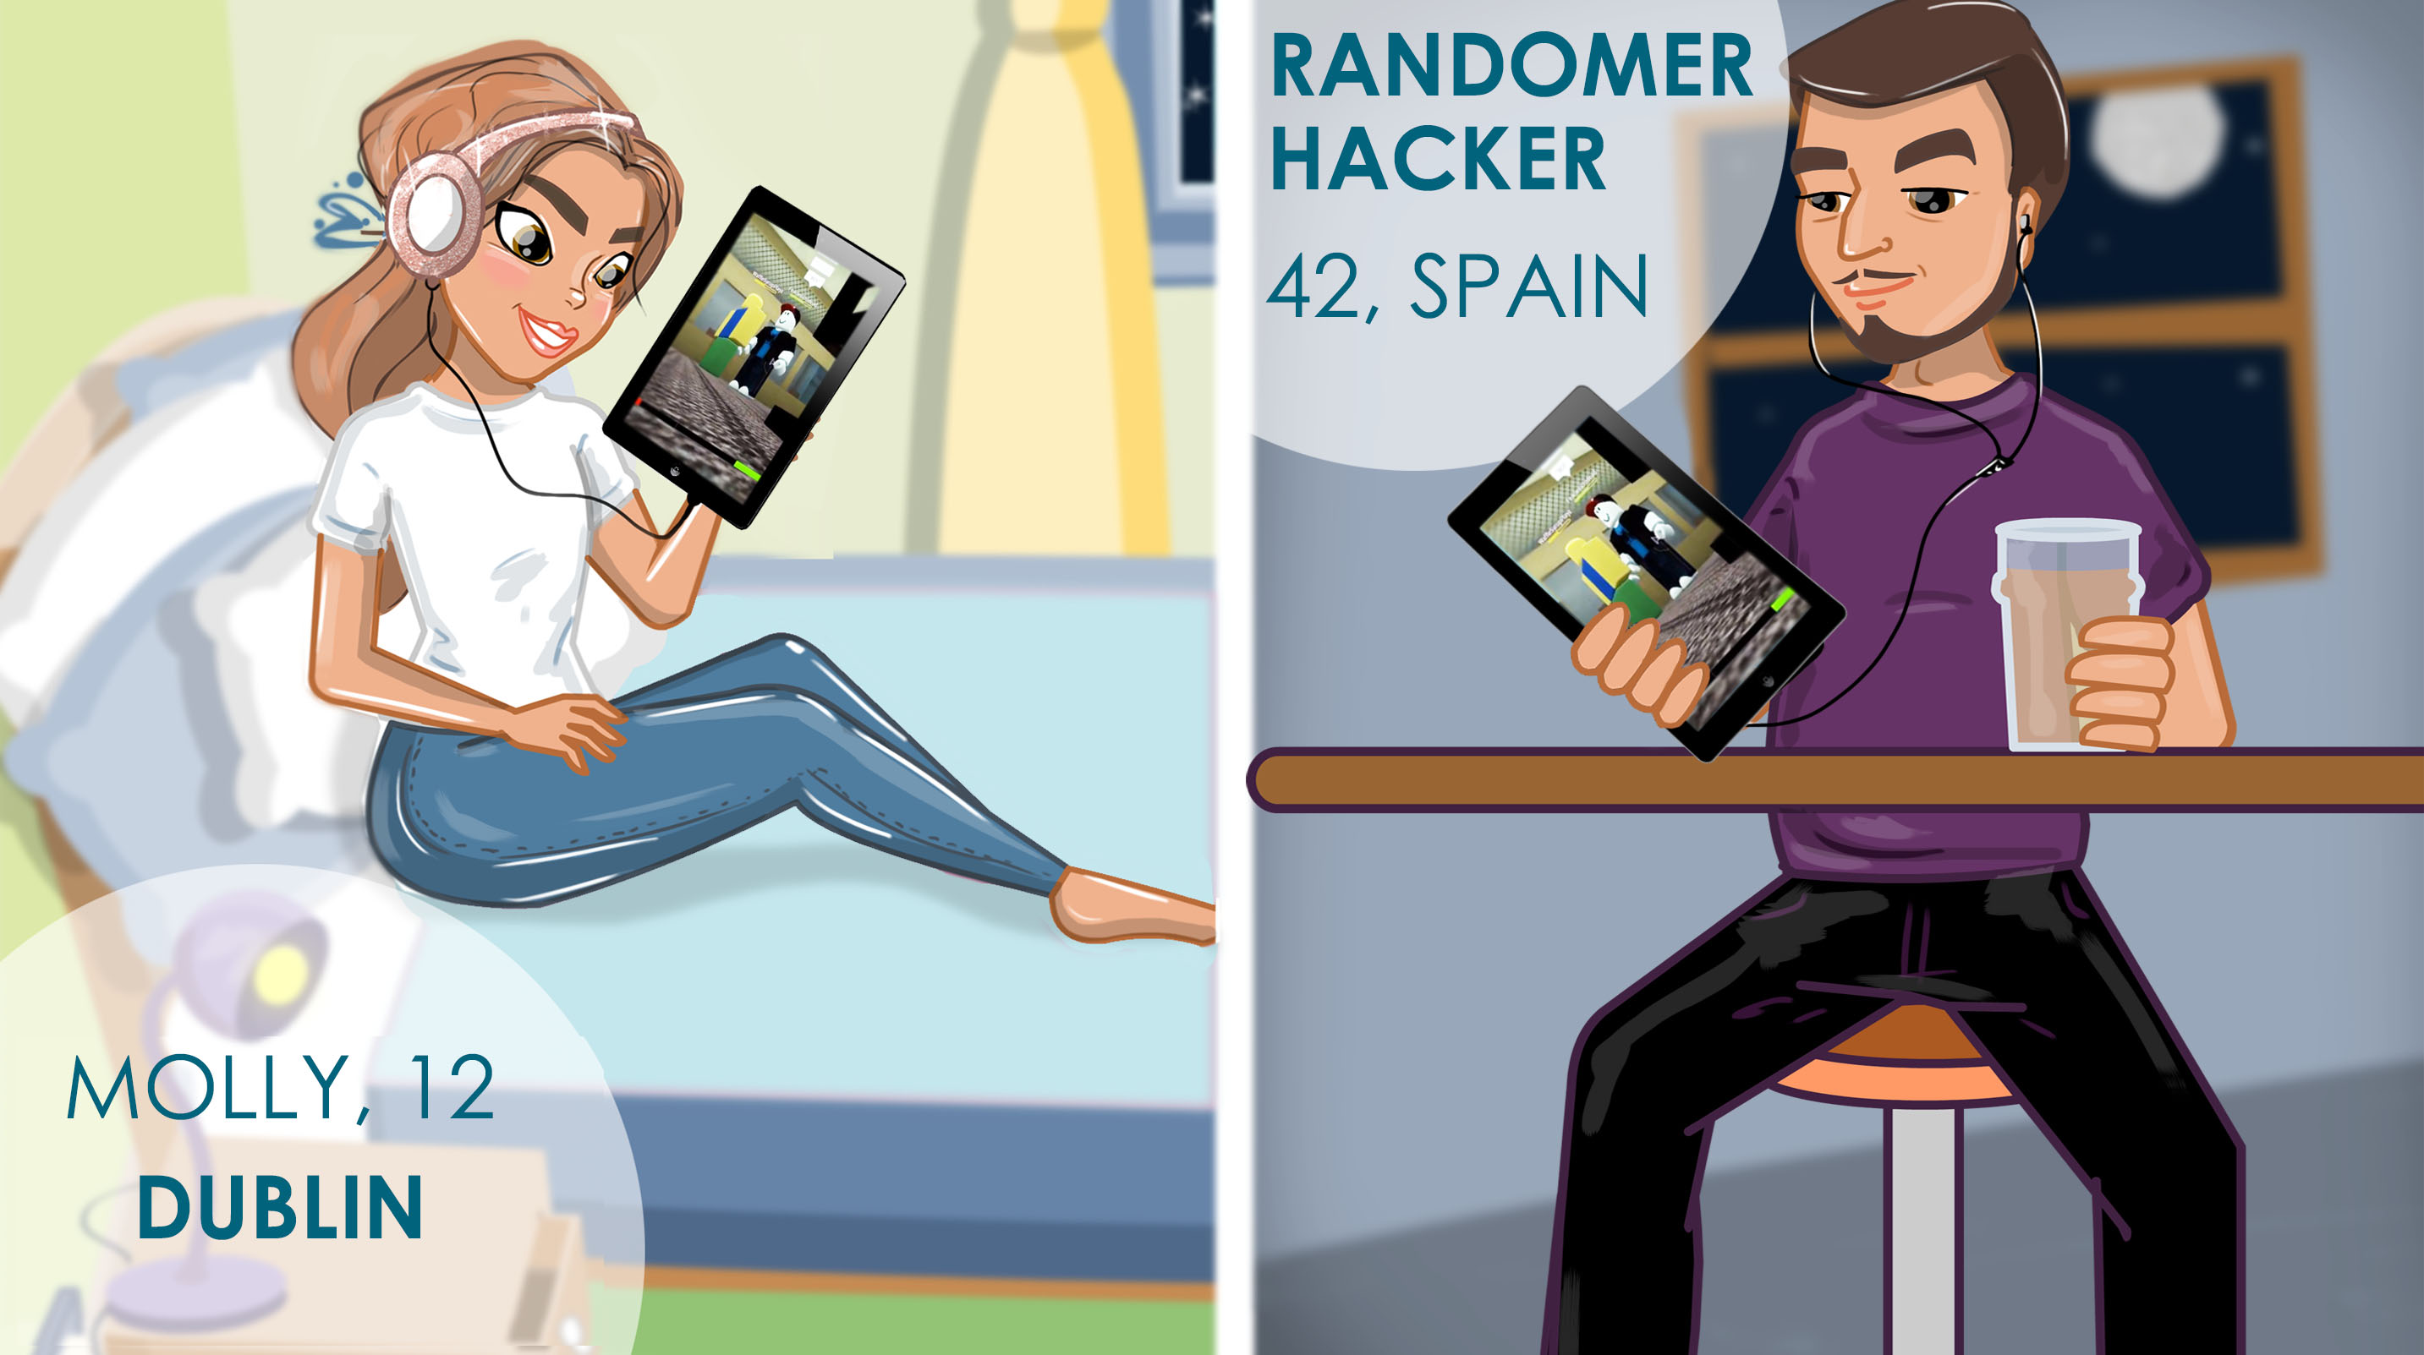
Notes:
Molly Scenario B
Now Molly is on one of her favourite games - Roblox. She thinks she is chatting to someone who is younger. She only sees an avatar.
The avatar is actually an older person, and Molly is unaware.
Without telling the students what is happening, ask the students to describe what is happening.
Ask them to advise what Molly should do. She should block this person on Roblox because she does not know them (in the real world first)

Slide 5
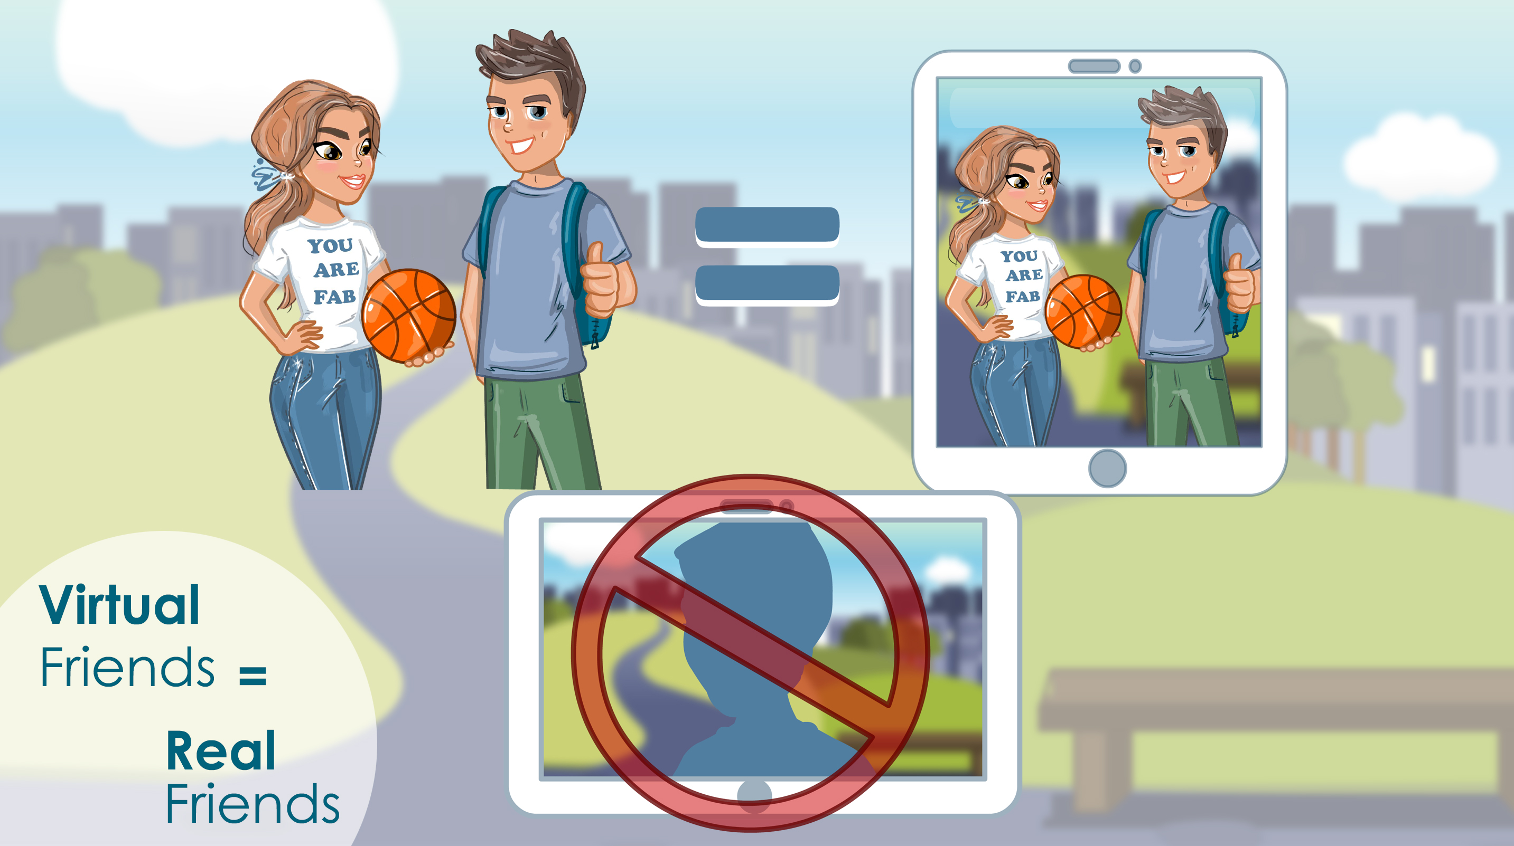
Notes:
Zeeko Rule:
The simple rule is: All our virtual world friends should be real world friends FIRST.
If I have never physically met someone, I can not be certain that they are who they say they are.
Ask the students how you can know someone is who they say they are online. Students may say ‘facetime them’ or ‘ask them personal questions’ to check that they are who they say they are, but this is risky and should not be done. The only true way is through the Zeeko rule “Virtual Friends = Real Friends”
Great tip for students:
Ask them what they would do if they got a friend request from someone in class when they were home one evening. What should they do? The correct answer is to not accept and wait until they see them in school or in person. They should ask if they tried to befriend them the night before. Only after confirming they know the other person in the real world first, should they accept the request.

Slide 6
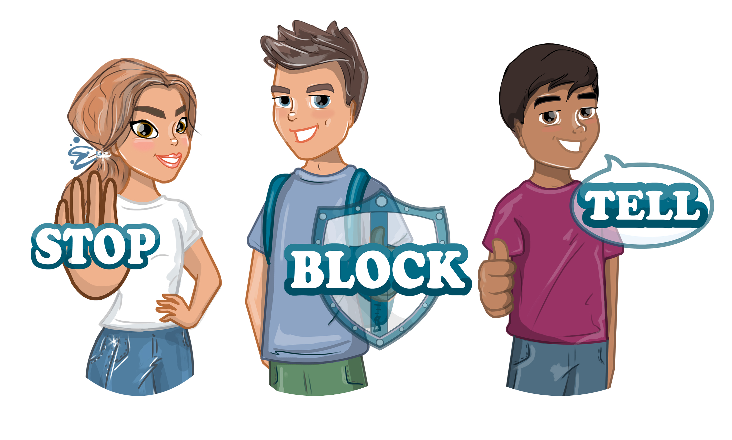
Notes:
Stop Block Tell Zeeko Rule
If you get a friend request from someone you don’t know or if a stranger starts chatting to you online, take the following steps:
Stop (Don’t respond)
Block the user
Tell your chatbudi (a chatbudi is an adult who is over 18 who you trust to talk to about your online friends and activities)

Slide 7
Group Discussion
What games or apps do people connect with other people?
What are ways that you can deal with comments or requests from people you don’t know?
Notes:
Group Discussion:
Ask the students what games or apps they know of where people connect with other people.
Many students (especially in the older classes) have played online games and may offer answers related to those experiences. These games include Roblox, Clash of Clans, Clash Royale, Minecraft and FIFA. On many apps children can connect with other people (e.g. You Tube, Snapchat, Musically, Instagram, FIFA, Minecraft)
After a brief discussion of different games and apps where people can connect with strangers online, ask the students to offer a list of solutions to deal with comments and requests from strangers. Write these on the board and have them all agree what actions they should take. These suggestions should include talking to a parent or trusted adult, blocking the username immediately, ensuring you never respond to the person with a reply and reporting the username for inappropriate language or behaviour. Remind them of the Zeeko rules again in slides 5 and 6.

Slide 8
Thank you
Notes:
Further information can be found:
www.zeeko.ie
Phone Clodagh 01-906 0291
Email: clodagh@zeeko.ie

